Slide 1
Diabetes prediction app
User Manual
RAYEARTH SHANKAR

Slide 2
Contents
About myself
Acknowledgements
Experience with clevered
About the app
How to use the app
Contact information

Slide 3
About the author
I am Rayearth Shankar , 20 years of age a passionate and ambitious B.Tech student. Currently in the second year, balancing academic excellence with a wide range of extracurricular activities, including table tennis, Taekwondo, and leadership roles in college clubs and committees.
An abacus competition merit holder and an active researcher, deeply involved in exploring innovative ideas and solutions through the ongoing research work. Looking ahead, to combine my technical expertise with business acumen to do better for the world in some way or another.

Slide 4
Acknowledgements
Throughout my journey with clevered, I have learnt a lot over the course in a couple months. It is all because of my parents enrolling me in the internship that I was given the chance to learn from enthusiastic , skilled and dedicated mentor Mr. Avishek sir. I appreciate his efforts and the patience they have had with not just myself but the other students as well.

Slide 5
Experience with Clevered
It was an enriching journey into the world of artificial intelligence. Under the guidance of my mentor, Mr. Avishek, I explored the application of AI in solving real-world problems. Cleavered's intuitive platform allowed me to understand complex AI concepts and tools in a hands-on manner.
Through this experience, I worked on project that showcased the power of automation and intelligent systems, honing my skills in critical thinking and problem-solving. Mr. Avishek’s mentorship was instrumental in helping me navigate challenges and develop innovative approaches to using AI effectively.

Slide 6
About the app
The Diabetes Prediction App is designed for individuals seeking to prevent diabetes, manage their lifestyle, or understand risk factors early. With this app, staying informed and proactive about your health has never been easier. An intelligent and user-friendly tool designed to assess your risk of developing diabetes.

Slide 7
How to use the app
After opening the app, provide correct information within the spaces provides.
Make sure the input is in numerical values and is correct
Note that ;
The pregnancy input is either 1, if the user is currently pregnant, or 0 if not. Naturally, a male user will put 0 as the input.
Most input values should be known but if any are unknown, use average values in case of normal health
After putting all the desired input you need to press the predict button to find the presence or absence of diabetes condition.

Slide 8
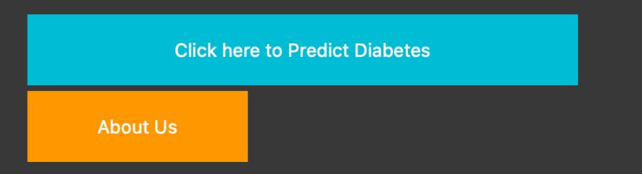
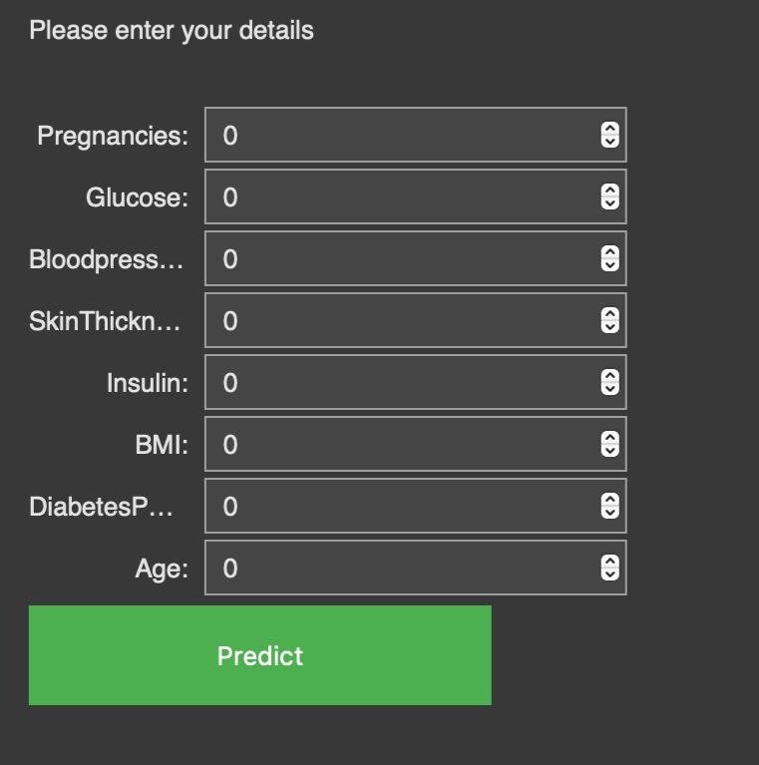
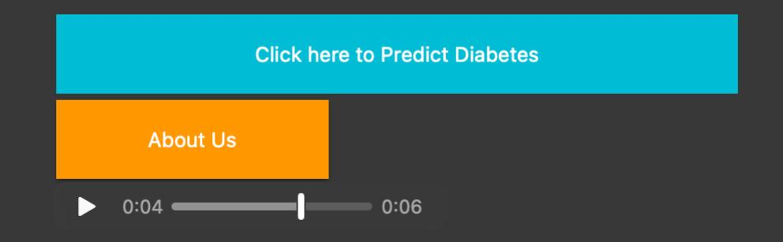
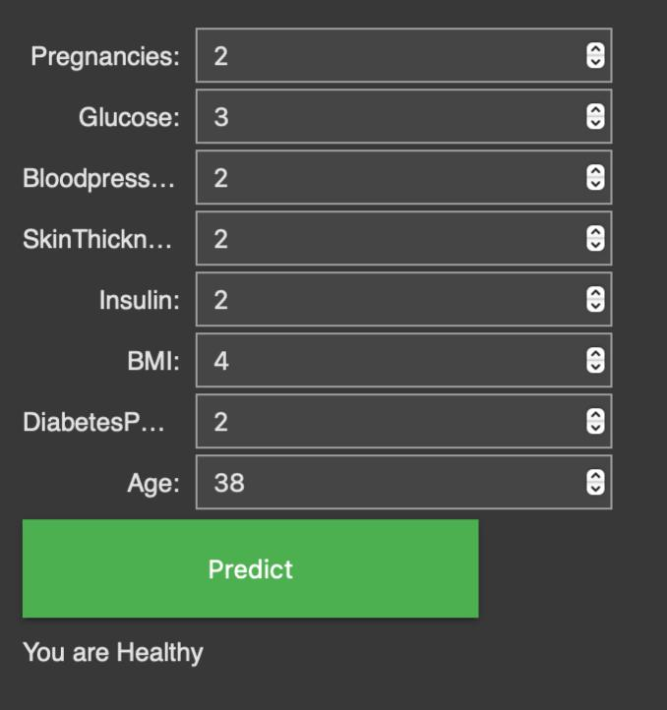
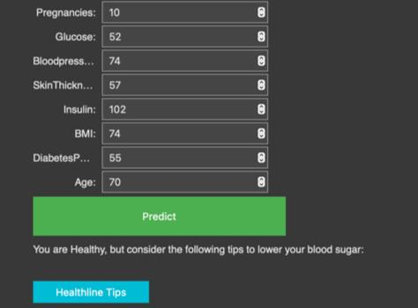
CLICK ON PREDICT DIABETS
CLICK TO KNOW ABOUT US
ENTER ALL THE INPUTS AS VALUES
OR
CLICK PREDICT

Slide 9
IF ANY QUERIES CONTACT ME FOR ANY HELP
EMAIL-ID: rayearth.shankar@gmail.com

